Slide 1
Audit Effort and the Unit Audit Price of Industry Specialist Auditors : Evidence from Korea
Gil S. Bae, SeungUk Choi, JoonHwa Rho

Slide 2
Contents
1. Research Questions
ISA or BIG N Auditor ➜ Quality ↑ ➜ Total Fee Premium ↑
Total Fee = Audit Efforts (Audit Hour) × Unit Audit Price per Audit Effort
Research Question ➜ Where does the Total Fee Premium come from?
2. Literature Review
Understanding : Korean accounting and audit markets
Literature Review : Audit quality, audit fees and audit effort
3. Hypotheses
H1 : Audit effort of ISA is different from that of non-ISA.
H2 : Unit audit price of ISA is different from that of non-ISA.
4. Data
period : 2002 to 2010, Database : TS-2000
Fiscal year-end of December, Listed KOSPI
Total 4,256 firm-year
5. Variable
Dependant variable : Log(Fees, Hours, or Fees per hour)
Independent variable : ISA(continuous or dummy) & control
6. Model
Main model & 2-Stage model(Heckman test, Propensity Score test)
7. Results
ISA charge higher total fees.
ISA spend more audit efforts (audit hour).
Unit audit price per audit effort is not different from non-ISA.
8. Conclusion
This indicates that ISA charge higher total audit fees than do non-ISA,
they also increase audit effort, not yielding a higher unit price.

Slide 3
Research Questions
ISA or BIG N Auditor ➜ Quality ↑ ➜ Total Fee Premium ↑
Total Fee = Audit Efforts (Audit Hour) × Unit Audit Price per Audit Effort
Research Question ➜ Where does the Total Fee Premium come from?
Higher Audit Efforts (Audit Hour)?
Higher Unit Audit Price?
Or Both?
Results
ISA charge higher total fees.
ISA spend more audit efforts (audit hour).
Unit audit price per audit effort is not different from non-ISA.

Slide 4
Literature Review
Korean accounting and audit markets
The Act on External Audit of Stock Companies : file audited financial statements annually with the FSS through an online system
2011 : K-GAAP → K-IFRS (F/S report : submit within 90 days, included auditor’s report)
1997 Asian financial crisis → audit committee of the Board of Directors
2003 : Class action lawsuits have been allowed.
Korean Big 4 auditors : affiliated to the international Big 4 auditors(Samil-PWC, Samjung-KPMG, Hanyoung-E&Y, Anjin-Deloitte)
Audit firms quality control programs : be reviewed periodically by the regulator(Big audit firms → FSS, Small audit firms → KICPA)

Slide 5
Literature Review
Audit quality, audit fees and audit effort
Simunic 1980; Palmrose 1986; Whisenant et al. 2003; Clatworthy et al. 2009; Lawrence et al. 2011 : Big N auditors → audit fee premium → because lack of competition or quality differences
These paper's confliction :
Differences investigated
Methodology
Dependent variables
Client listing status and client size

Slide 6
Literature Review
Audit quality, audit fees and audit effort
<Audit Quality research>
Dunn and Mayhew(2004) : ISA understand company’s characteristics → audit quality is predicted to be higher.
Gramling et al.(2001) : Positive association between ISA and the prediction ability of future cash flows.
Balsam et al.(2003) : ISA lower levels of discretionary accruals and higher earnings response coefficients.
Krishnan(2003) : ISA lower levels of discretionary accruals.
Carcello and Nagy(2004) : ISA are less likely to be involved in SEC enforcement actions.
Ahmed et al.(2008); Li et al.(2010); Fernando et al.(2008) : ISA significantly reduces cost of equity and debt.

Slide 7
Literature Review
Audit quality, audit fees and audit effort
<ISA audit fee premium>
Palmrose(1986) : Auditor size has a significantly positive association with both audit fees and audit hours, no significant relation is observed between industry specialization and either audit fees or audit hours.
Casterella et al.(2004) : Industry specialization can lead to a fee premium.
Francis et al.(2005) : Audit fee premium in city-level ISA.
Simunic(1980) : ISA audit fee premiums factor is that ISA provide higher quantity of audit services or charge a higher unit price for their effort.

Slide 8
Hypotheses
Audit Efforts (Audit Hour)
ISA concerned about reputation losses and litigation exposure → Increase audit hours(Lim and Tan, 2008).
ISA can achieve the same level of assurance by spending less effort → lower audit effort.
If ISA spend more(less) effort, then net effect of higher audit fees is ambiguous.
Unit Audit Price per Audit Effort
ISA spread their fixed costs → leading to a lower unit price.
Higher audit quality & MKT dominance (lack of competition) → higher unit price.

Slide 9
Hypotheses
Hypotheses
H1 : Audit effort of ISA is different from that of non-ISA.
H2 : Unit audit price (i.e., audit fees per audit hour) of ISA is different from that of non-ISA.

Slide 10
Data
Sample period : 2002 to 2010
Database : TS-2000
Fiscal year-end of December
KOSPI
Continuous variables at the 1% winsorized.
Missing financial and audit information data deleted.
Industries with fewer than 20 per two-digit industry-year observations are deleted.
Final sample consists of 4,256 firm-year.

Slide 11
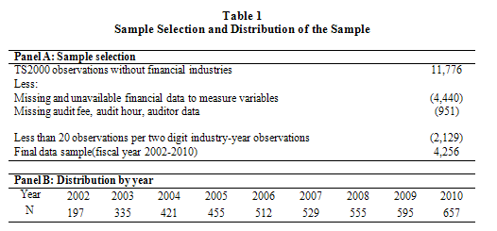
Data

Slide 12
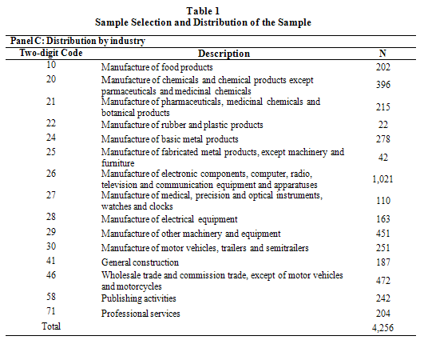
Data

Slide 13
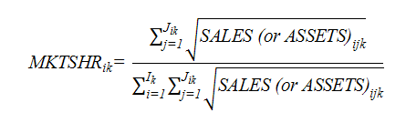
Variable
Dependant Variable : Log(Fees, Hours, or Fees per hour)
ISA : continuous variable or dummy variable.
(1) a continuous measure of the market share (Lim and Tan 2008),
(2) any auditor with a market share of 20% or more (Mayhew and Wilkins 2003),
(3) the auditor with the largest industry market share and its market share exceeding 10% higher than the second largest auditor(Mayhew and Wilkins, 2003; Lim and Tan, 2008).
Market Share : use client sales and total assets

Slide 14
Variable
Control variable :
Log(TA) : the natural log of total assets
Leverage : total liabilities divided by total assets
Holdings : ownership of largest shareholder and related parties
ROA : net income divided by total assets
Loss : a dummy variable that takes 1 if the firm reported a loss during previous year
Complexity : receivables and inventory divided by total assets
Foreign : Foreign ownership
Opinion : a dummy variable that takes 1 if the firm receives a modified audit opinion
Big N : a dummy variable that takes 1 if the auditor is a Big N auditor
Tenure : the length of the auditor-client relationship in years
Initial Audit : a dummy variable that takes 1 if the audit is an initial audit engagement
year dummies and industry dummies

Slide 15

Research Model
Main model :
2-Stage model :
First-stage(Heckman test) :
First-stage(Propensity Score test) :

Slide 16
Results
Table 2
Description of the sample
Panel A: Mean and (median) for sample
Variable | (1) Total | (2) ISA | (3) Non-ISA | Test of the difference (2)-(3): t[z]-value
Log (Fees) | 17.84 (17.73) | 18.19 (18.06) | 17.74 (17.70) | 17.72*** [17.75]***
Log (Hours) | 6.33 (6.33) | 6.79 (6.80) | 6.21 (6.25) | 17.88*** [20.69]***
Log(Fees per hour) | 11.50 (11.42) | 11.41 (11.31) | 11.53 (11.44) | 5.58*** [7.50]***
Abnormal fees | -0.00 (0.00) | 0.00 (-0.00) | -0.00 (0.00) | 0.97 [0.44]
Abnormal hours | -0.01 (0.00) | -0.00 (0.01) | -0.01 (0.00) | 1.98** [1.97]**
Audit quality 1 | 0.08 (0.06) | 0.06 (0.04) | 0.08 (0.06) | 8.04*** [7.57]***
Audit quality 2 | 0.08 (0.06) | 0.06 (0.04) | 0.08 (0.06) | 7.96*** [7.33]***
Log(TA) | 18.38 (18.14) | 19.22 (19.11) | 18.15 (18.02) | 19.64*** [19.61]***

Slide 17
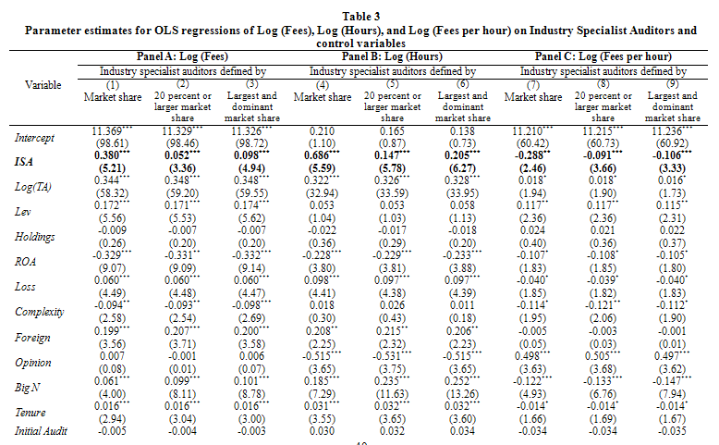
Results

Slide 18
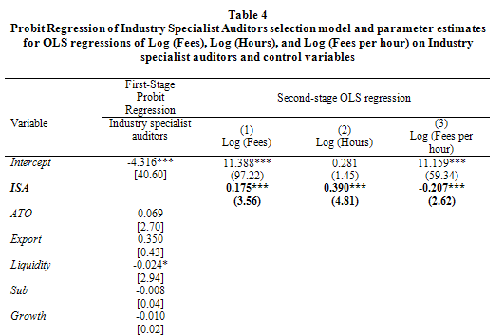
Results

Slide 19
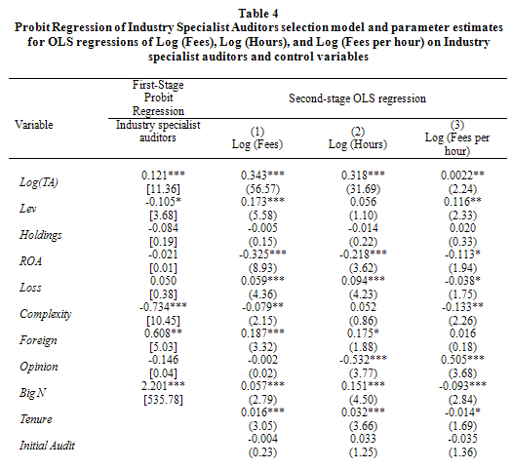
Results

Slide 20
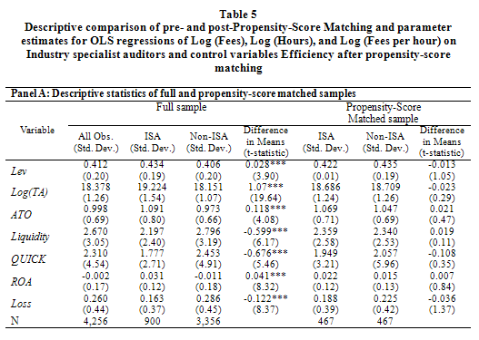
Results

Slide 21
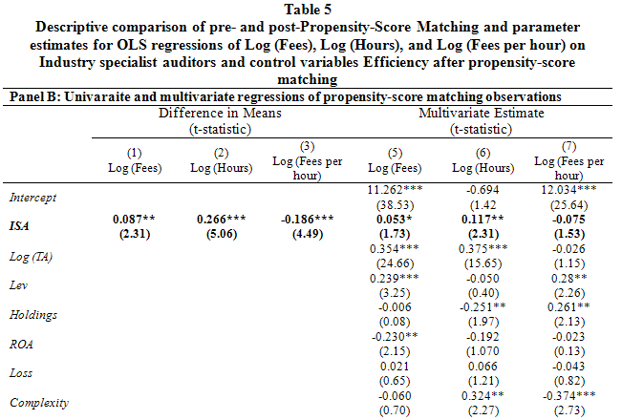
Results

Slide 22
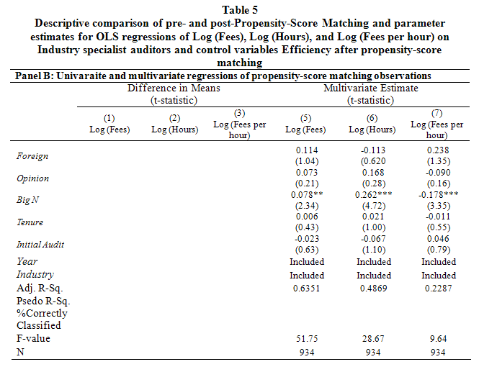
Results

Slide 23
Results
Additional analyses
Industry specialist auditors and client firm accounting quality → association between ISA and AQ, TABLE 6.
Client size effects → Subsample(SIZE), TABLE 7.
Market dominance and audit effort → dominance Share more than 30%, 40% Sample, TABLE 8.
Competition in client firm industry → Competition proxied by the Herfindahl-Hirschman index, the industry product substitutability(DIFF), the level of entry costs in industry(ENTCOST), the level of market size in industry(MKTSIZE), TABLE 9.
Client firm governance levels → Subsample of Governance, TABLE 10.
Results are consistent with main results.

Slide 24
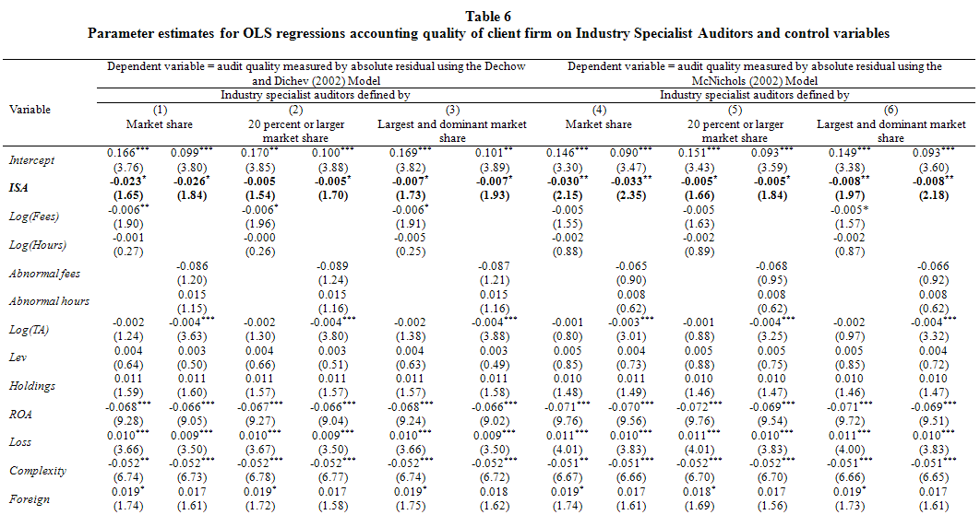
Results

Slide 25
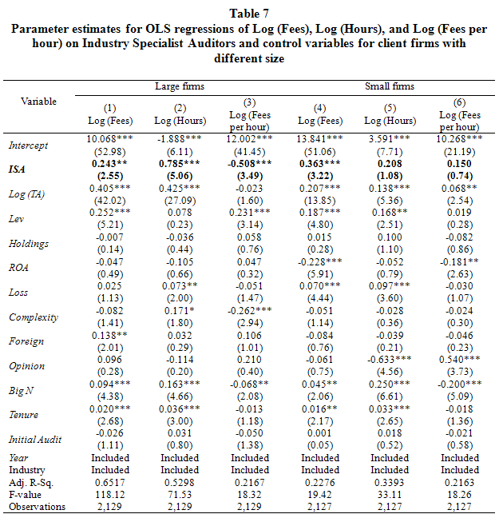
Results

Slide 26
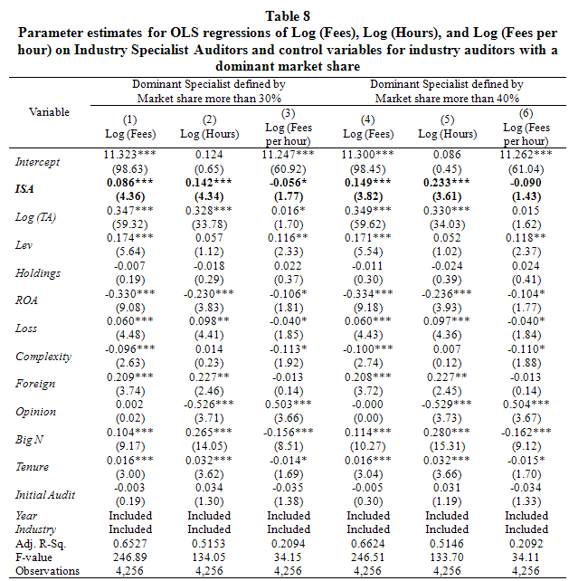
Results

Slide 27
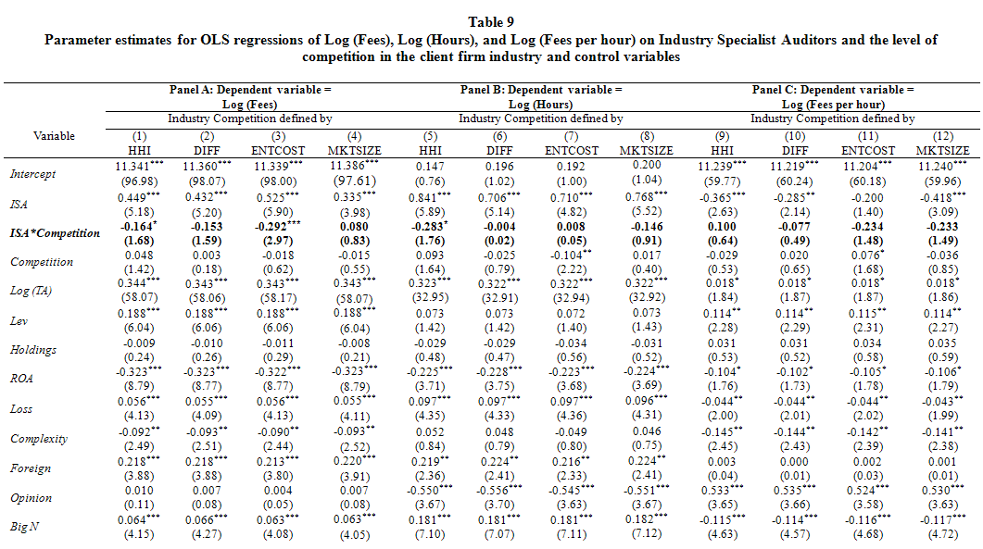
Results

Slide 28
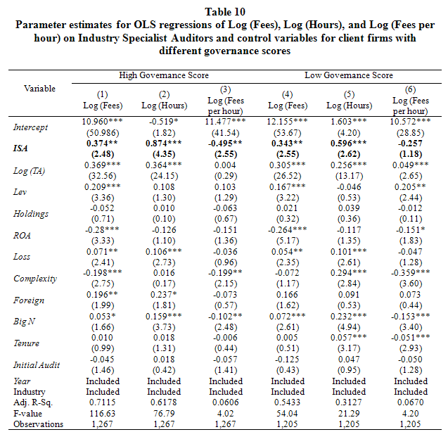
Results

Slide 29
Conclusion
Differences in audit fees can represent quantity differences in audit effort or unit price differences.
Korea → Audit effort information is required to be disclosed in the firms’ annual reports.
Thus, ISA spend more audit effort? OR ISA charge higher audit fees because they spend more effort? OR ISA higher audit fees because they charge a higher unit price? OR both?
Results : ISA charge higher total audit fees, spend more audit effort. unit price per audit effort of ISA is not different from non-ISA.
This indicates that ISA charge higher total audit fees than do non-ISA, they also increase audit effort, not yielding a higher unit price.
The results are robust to several sensitivity checks.

